Slide 1

Lesson 7 CN4003:
Advance CSS 3
Dr Fadi Safieddine
1
Dr. Fadi Safieddine copyright 2021

Slide 2

Lecture Content:
What is CSS3?
CSS features:
Using Borders
Adding Text Effects
Changing Fonts
Creating 2D Transformations
Creating 3D Transformations
Adding page Transitions
Adding simple Animations
Other selectors
2

Slide 3

What is CSS3?
Early drafts started as early as 1999.
Is based on modules (rather than single file support as was the case for CSS).
Not all browsers support all its modules yet. (http://www.w3schools.com/cssref/css3_browsersupport.asp)
Some browsers require special prefix to get their code working.
So sometimes you need to write the same code five times to make it work for most popular browsers
Some of the prefix still in use:
3

Slide 4
Before we start:
We need to go through few basic geometry in order to know how to program.

Slide 5
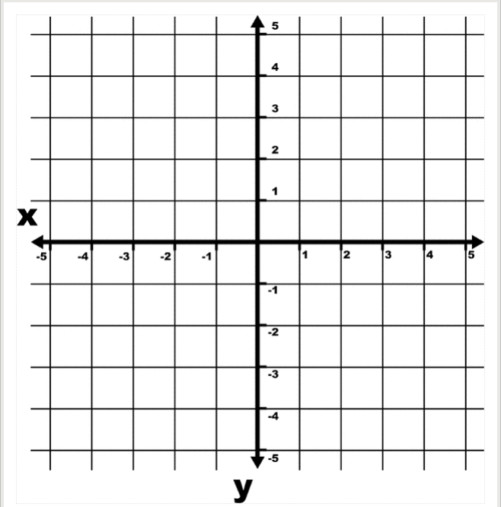
CSS3 Space
This is basic geometry
+Y
-X
+X
+Y

Slide 6
CSS3 Space
This is how CSS codes work
Top
Left
Right
Bottom

Slide 7
CSS3 Space
This is how rotations work
Top
Left
Right
Clock-wise
Bottom

Slide 8
CSS 3 Borders
Borders can have:
Radius: border-radius
Shadow: box-shadow
And border image: border-image
The border can be made of an image. Not compatible with all browsers.
Border Syntax:
Border-(Sub property): (Top) (Right) (Bottom) (Left) ;
Sub-property can be: width, color, style, and radius. Top, right, bottom, left: all four values have to be defined.
8

Slide 9
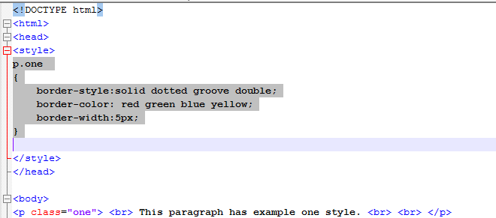
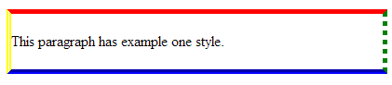
CSS3 Borders
Example 1: Border Style / color / width
9
Notes:
9

Slide 10
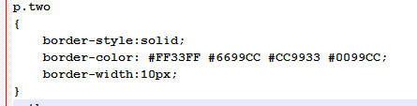
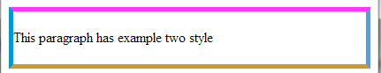
CSS3 Borders
Example 2: Border color :
10
Notes:
10

Slide 11
End of Part 1
Lab activity 7.1: Go back to your first HTML page.
Add Embedded CSS to style your paragraphs with borders as shown in example 1 or 2.

Slide 12
Part 2
CSS3 Borders
12
Notes:
12

Slide 13
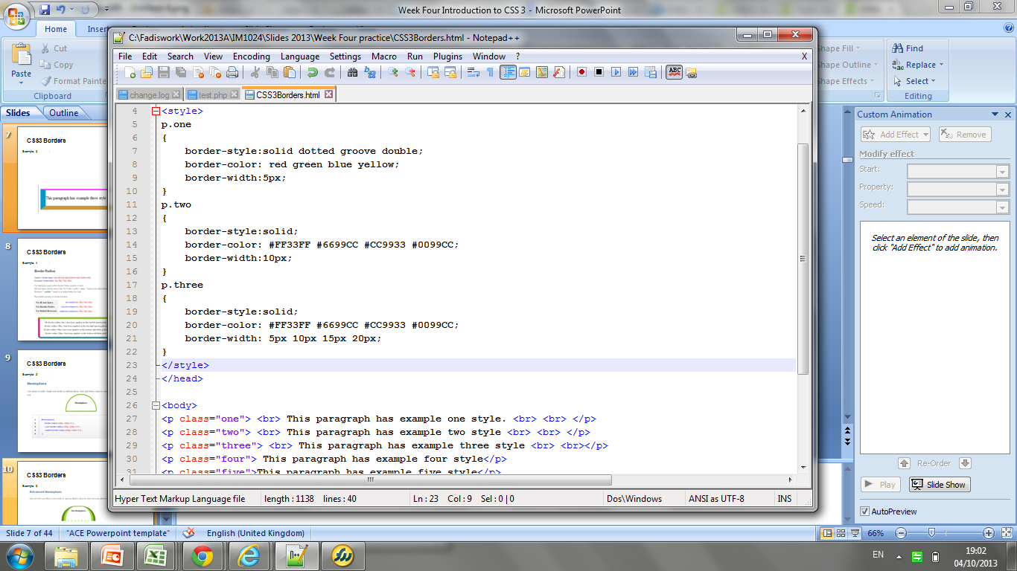
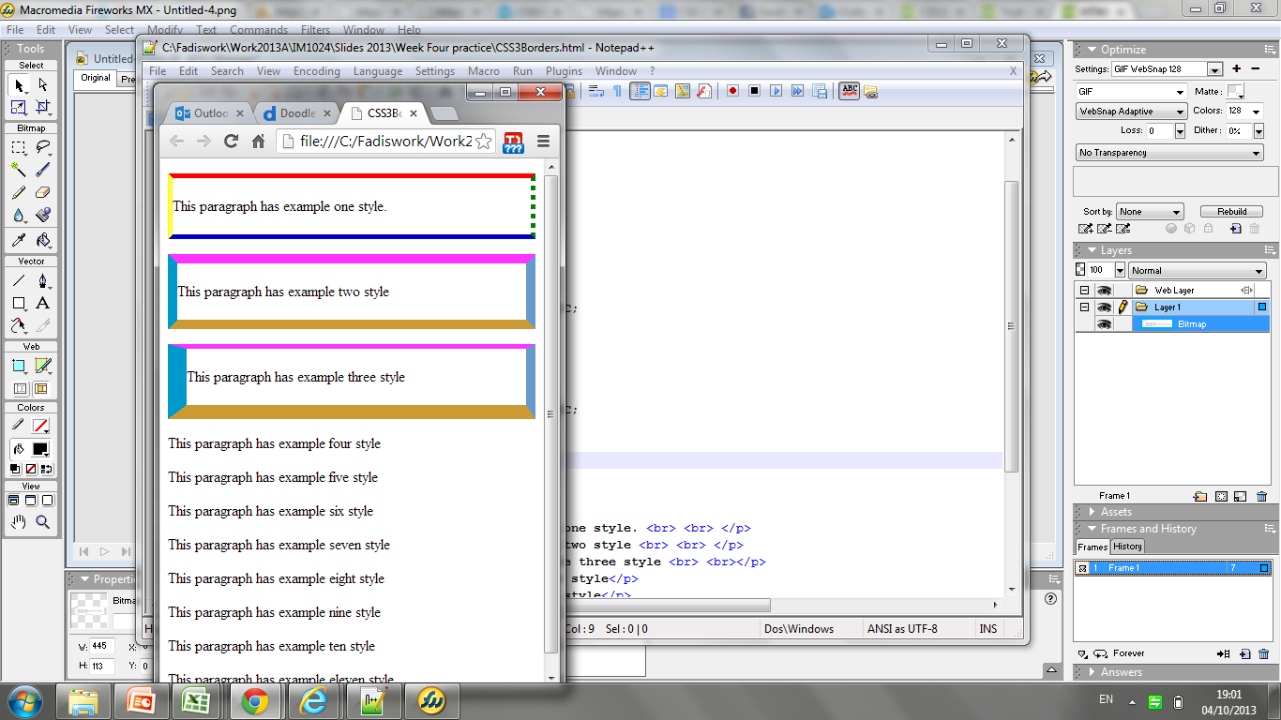
CSS3 Borders
Example 3: Border size :
13
Notes:
13

Slide 14
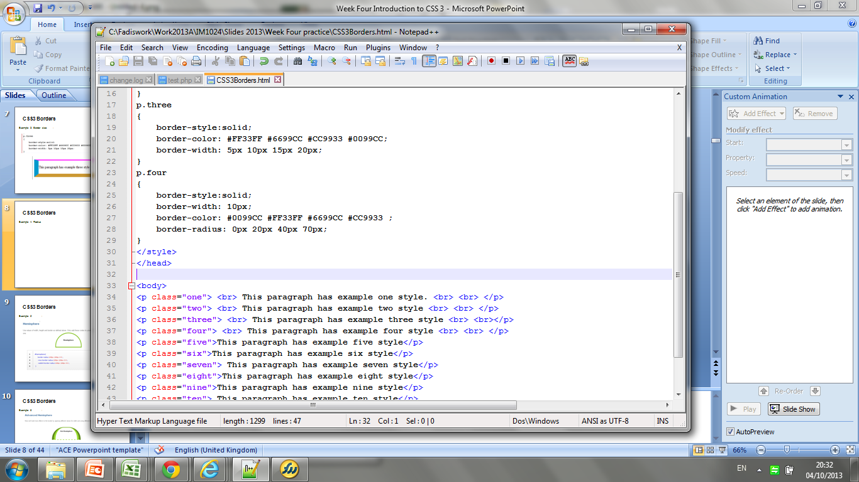
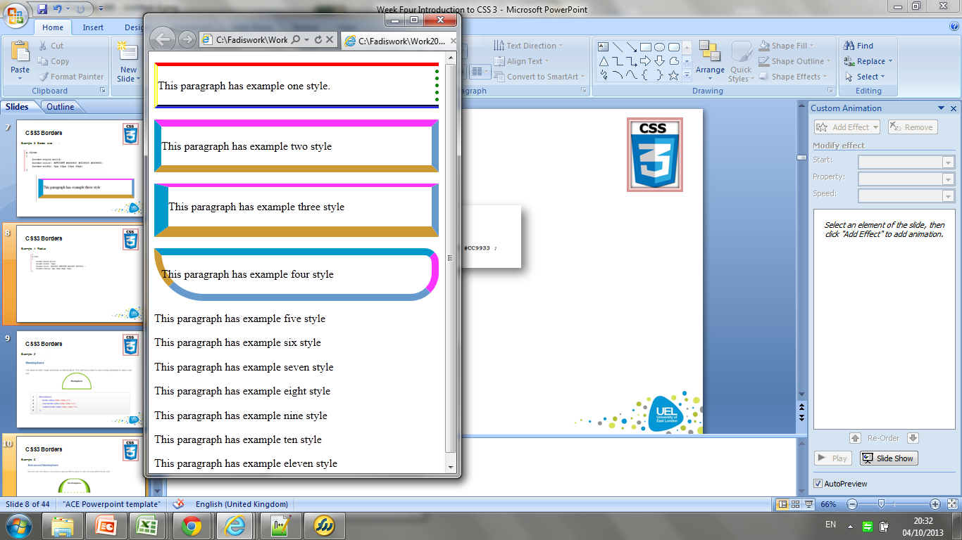
CSS3 Borders
Example 4: Radius
14
Notes:
14

Slide 15
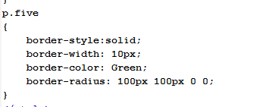
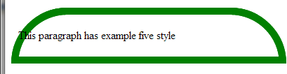
CSS3 Borders
Example 5: Hemisphere
15
Notes:
15

Slide 16
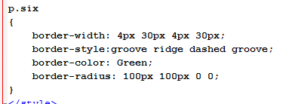
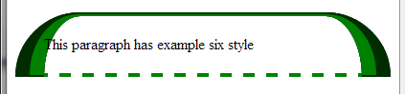
CSS3 Borders
Example 6: Advanced Hemisphere
16
Notes:
16

Slide 17
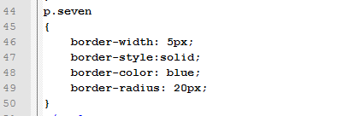
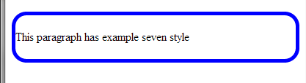
CSS3 Borders
Example 7: Round Rectangle borders :
17
Notes:
17

Slide 18
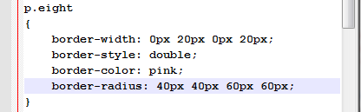
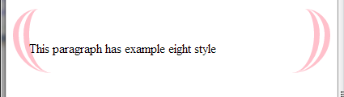
CSS3 Borders
Example 8: Advance Round Rectangle
18
Notes:
18
Note that the top bit of the rectangle is zero to make it look disappeared.

Slide 19
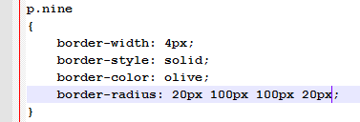
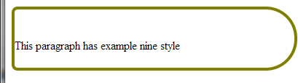
CSS3 Borders
Example 9: Bullet
19
Notes:
19

Slide 20
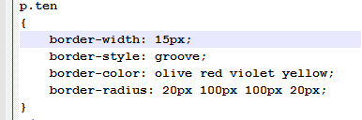
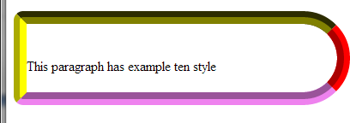
CSS3 Borders
Example 10: 3D like border
20
Notes:
20

Slide 21
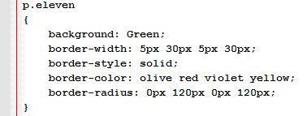
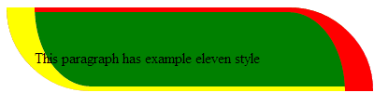
CSS3 Borders
Example 11: Leaf like design
21
Notes:
21

Slide 22
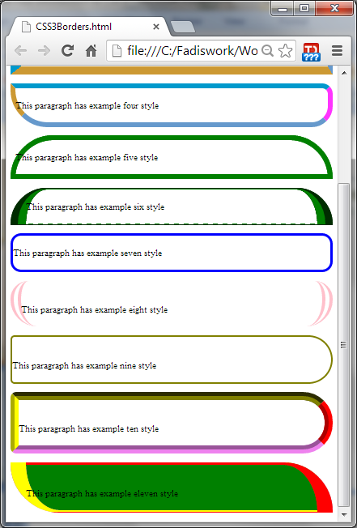
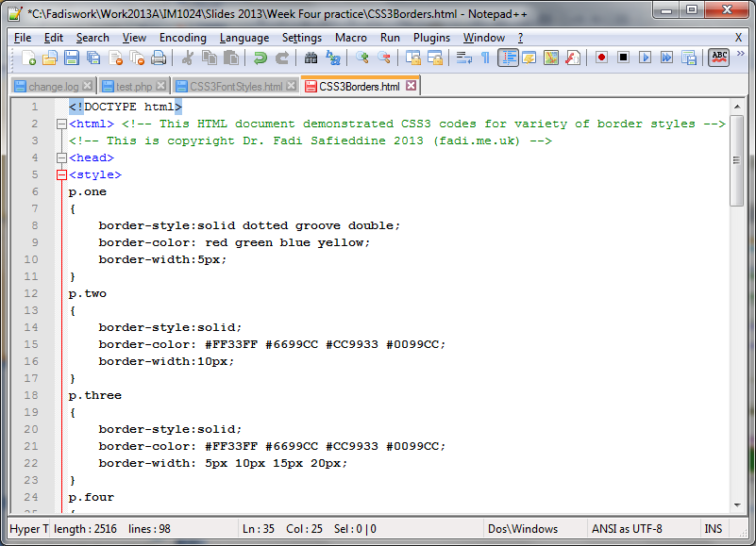
CSS3 Borders
Check Moodle supporting folder for this week you will find all the codes demonstrated in this practice.
File name: CSSborders.html
22
Notes:
22

Slide 23
End of Part 2
Lab activity 7.2: Go back to your first HTML page.
Add Embedded CSS to style your paragraph with any of the designs listed from 3 to 11. You only need to demonstrate one of them.

Slide 24

CSS3 Text special effects:
Part 3
24
Notes:
24

Slide 25

CSS3 Text special effects:
CSS3 allows designers to create variety of very interesting effects.
Because these are generated by the browser they would not take extra
space on the page like images would.
25
Notes:
25

Slide 26
CSS3 Text special effects:
Syntax:
Text-shadow: (x-offset) (y-offset) (blur-radius) (color)
X-Offset: To position the shadow along the x-axis.
Y-Offset: To position the shadow along the y-axis.
Blur-radius: To set the amount of blur where 0 is solid, 100 is so blurred it is invisible.
Color: To set the color of the shadow.
Lets see next examples of how they work.
26
Notes:
26

Slide 27
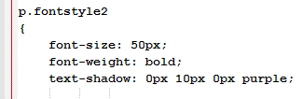
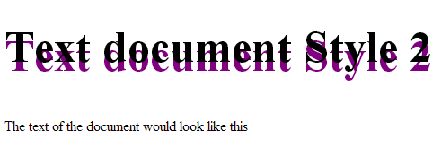
CSS3 Text special effects:
Style 1: Single Shadow
(x-offset) (y-offset) (blur-radius) (color)
27
Notes:
27

Slide 28
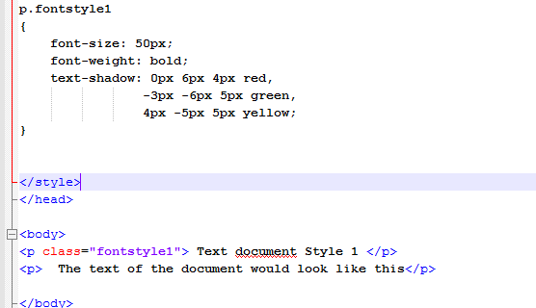
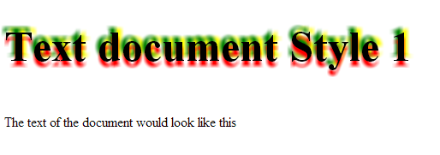
CSS3 Text special effects:
Style 2: Triple Shadow
(x-offset) (y-offset) (blur-radius) (color)
28
Notes:
28

Slide 29
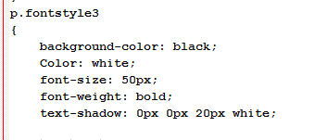
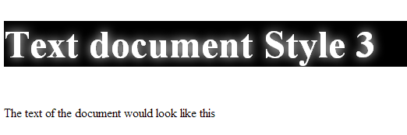
CSS3 Text special effects:
Style 3: Text Glow (neon style)
(x-offset) (y-offset) (blur-radius) (color)
29
Notes:
29

Slide 30
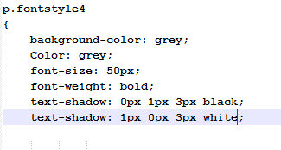
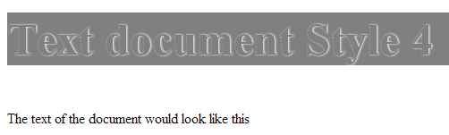
CSS3 Text special effects:
Style 4: Outset Style
30
Notes:
30

Slide 31
End of Part 3
Lab activity 7.3: Go back to your first HTML page.
Create a special effect font for your web page title base on any of the examples explained earlier.

Slide 32

CSS3 BOX shadows
Part 4
32
Notes:
32

Slide 33
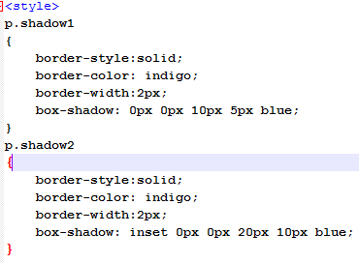
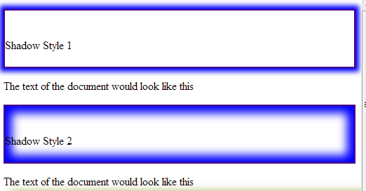
CSS3 BOX shadows
Box Shadows effect uses CSS Shadow Property. We have two types:
1- CSS Shadow property on the outer side of the div.
2- CSS Shadow property on the inner side of the div.
This property works on all browsers although some a ‘prefix’ needed.
box-shadow: X-shadow Y-shadow blur spread color
33
Notes:
33

Slide 34
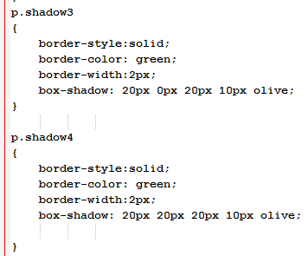
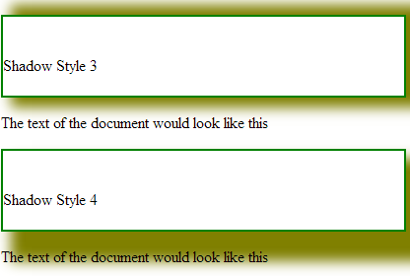
CSS3 BOX shadows
34
Notes:
34

Slide 35
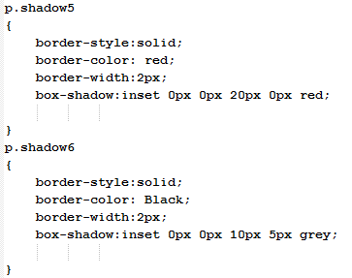
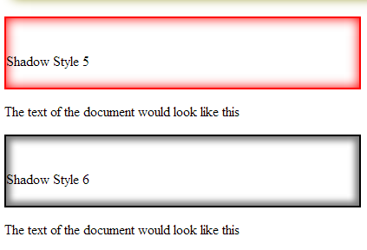
CSS3 BOX shadows
35
Notes:
35

Slide 36
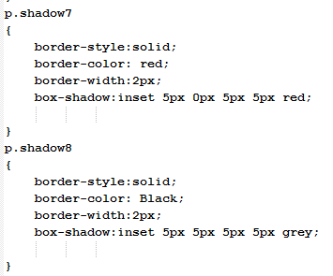
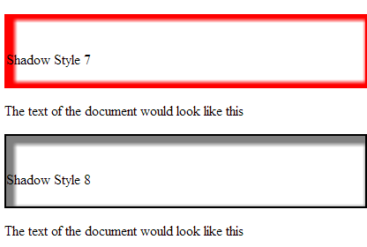
CSS3 BOX shadows
36
Notes:
36

Slide 37
End of Part 4
Lab activity 7.4: Go back to your first HTML page.
Create a shadow effect font for your first paragraph base on any of the examples explained earlier.

Slide 38

CSS3 Transforms & Transitions
Part 5
38
Notes:
38

Slide 39
CSS3 Transforms & Transitions
Transforms: Allows you to transform an item on the page to: rotate, scale, or skew.
Translate: Allows you to move elements: left, right, up, or down.
Important points:
When you employ a translate function, the element moves without effecting the flow of the document.
Unlike position: relative, which allows you to position an element either against its current position or against a parent or other ancestor, a translate element can only be moved relative to its current position.
The translate(x,y) function moves an element by x-axis, and y-axis.
39
Notes:
39

Slide 40
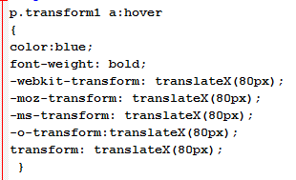
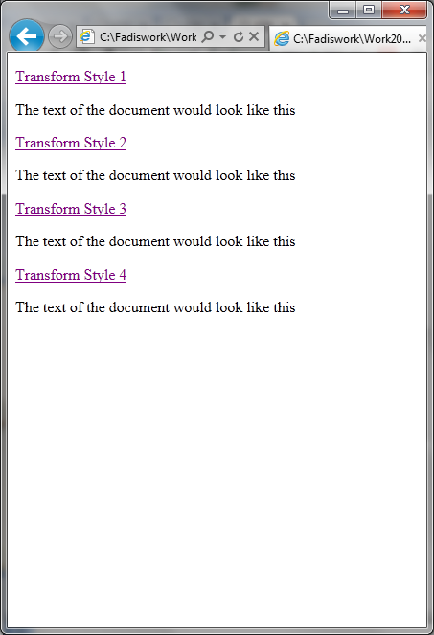
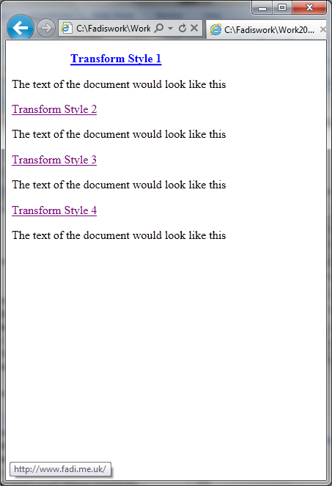
CSS3 Transforms & Transitions
Examples
Say we want to move the word “transform” over to the right when the user hovers over it,
40
Notes:
40

Slide 41
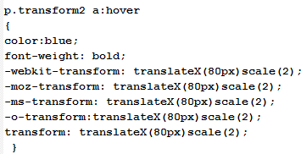
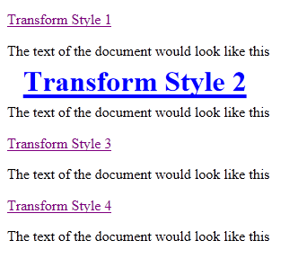
CSS3 Transforms & Transitions
Scaling
The scale(x,y) function scales an element by the defined factors horizontally and vertically, respectively. If only one value is provided, it will be used for both the x and y scaling.
Let us scale the same example
41
Notes:
41

Slide 42
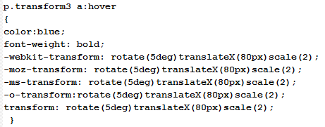
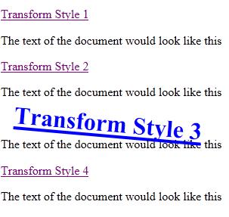
CSS3 Transforms & Transitions
Rotation
The rotate() function rotates an element around the point of origin (as with scale,by default this is the element’s center), by a specified angle value. Generally, angles are declared in degrees, with positive degrees moving clockwise and negativemoving counter-clockwise.
42
Notes:
42

Slide 43
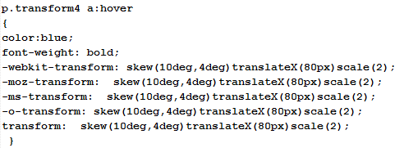
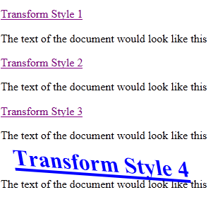
CSS3 Transforms & Transitions
Skew
The skew(x,y) function specifies a skew along the X and Y axes. As you’d expect, the x specifies the skew on the X axis, and the y specifies the skew on the Y axis.
If the second parameter is omitted, the skew will only occur on the X axis:
43
Notes:
43

Slide 44
End of Part 5
Lab activity 7.5: Go back to your first HTML page.
Add a transform effect to the hyperlink or email address on your page.
Save your page.

Slide 45
CSS3 Transforms & Transitions
Part 6
45
Notes:
45

Slide 46
CSS3 Transforms & Transitions
Transitions:
Transitions allow the values of CSS properties to change over time, essentially providing simple animations.
For example, if a link changes colour on hover, you can have it gradually fade from one colour to the other, instead of a sudden change.
Steps:
1. Declare the initial state of the element as your start point (Default).
2. Declare the trigger of the transitioned element; for example- in a hover state. (Event)
3. State the setting that will change to the: transition-property, transition-duration, transition-timing-function, and transition-delay.
List of properties:
■ background-color and background-position ■ border-color, border-spacing, and border-width ■ bottom, top, left, and right ■ clip ■ color ■ crop ■ font-size and font-weight ■ height and width ■ letter-spacing ■ line-height ■ margin ■ max-height, max-width, min-height, and min-width ■ opacity ■ outline-color, outline-offset, and outline-width ■ padding ■ text-indent ■ text-shadow ■ vertical-align ■ visibility ■ word-spacing ■ z-index
46
Notes:
46

Slide 47

CSS3 Transforms & Transitions
Step 1: Decide on transition-duration:
The transition-duration property sets how long the transition will take.
You can specify this either in seconds (s) or milliseconds (ms).
Let us say our animation to be fairly quick, so we specify 0.2 seconds, or 200 milliseconds:
47
Notes:
47

Slide 48

CSS3 Transforms & Transitions
Step 2: Set the transition-timing-function:
The transition-timing-function lets you control the pace of the transition in even more granular detail.
Do you want your animation to start off slow and get faster, start off fast and end slower.
You can specify one of the key terms ease, linear, ease-in, ease-out, or ease in-out.
The best way to familiarize yourself with them is to play around and try them all.
48
Notes:
48

Slide 49

CSS3 Transforms & Transitions
Step 3: Decide on possible transition-delay
Normally, a transition begins immediately, so the default is 0. Include the number of milliseconds (ms) or seconds (s) to delay the transition:
CSS transition-timing-function Property (w3schools.com)
49
Notes:
49

Slide 50


CSS3 Transforms & Transitions
Transition:
With four transition properties and at least three vendor prefixes, you could end up with 16 lines of CSS for a single transition!!
Remember order of the values is important and must be as follows (though you do not need to specify all four values):
1. transition-property
2. transition-duration
3. transition-function
4. transition-delay
50
Notes:
50

Slide 51

Transition

Slide 52

CSS3 Animation
Introduction:
Transitions animate elements are limited in what they can achieve. CSS animations, unlike transitions, allow you to control each step of an animation via keyframes.
A keyframe is a snapshot that defines a starting or end point of any smooth transition.
With CSS transitions, we are essentially limited to defining the first and last keyframes.
CSS Animation allow us to add any number of keyframes in between, to guide our animation in many ways.
Animation properties:
animation-name
animation-duration
animation-timing-function
animation-iteration-count
animation-direction
animation-delay
animation-fill-mode
Code: @Keyframes or @-webkit-Keyframes
52
Notes:
52

Slide 53


CSS3 Animation
An example: simple animation
53
Notes:
53

Slide 54

Animation

Slide 55
End of Part 6
Lab activity 7.6: Go back to your first HTML page.
Add a transition or animation effect on your image.

Slide 56
CSS3 Gradients
Part 7
56
Notes:
56

Slide 57


CSS3 Gradients
We can use CSS 3 to create some subtle gradients.
CSS 3 Gradients require several values to account for when projecting your gradient and it only worsens when working with radial gradients.
background:
linear-gradient(pos, #AAA B, #XXX Y); or radial-gradient(pos, #AAA B, #XXX Y); pos = the position of the first colour, giving direction to the gradient #AAA = primary colour B = where the fade begins (%) #XXX = secondary colour Y = where the fade begins (%)
The -webkit-gradient() is built slightly differently but works in the same manner, creating a start position and then the colors from() and to();
57
Notes:
57

Slide 58


CSS3 Gradients
58
Notes:
58

Slide 59

Lab Practice:
Test all these CSS3 codes on your own using different browsers you have.
Those that do not work, check the W3Schools website to see if a newer browser is more compatible.
http://www.w3schools.com/cssref/css3_browsersupport.asp
Those that may need Prefix, add them.
59
Notes:
59

Slide 60
Quick thought

Slide 61
End of Part 7
Lab activity 7.7: Edit the page you have been working on to add the gradient background with colours of your choice.
Now save your page and submit as one page for review.

